Slide 1
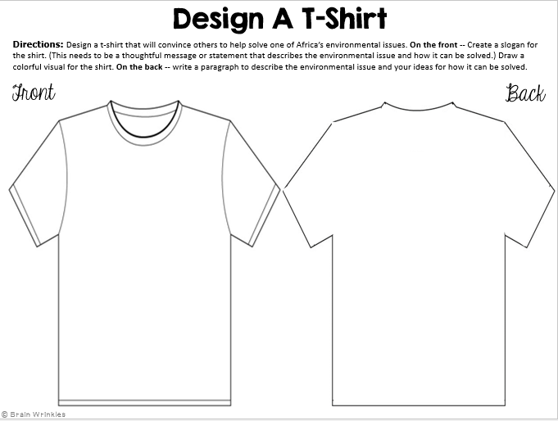
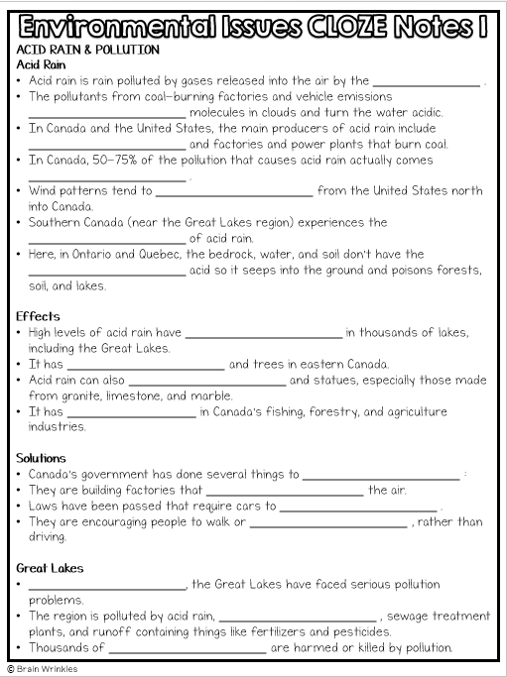
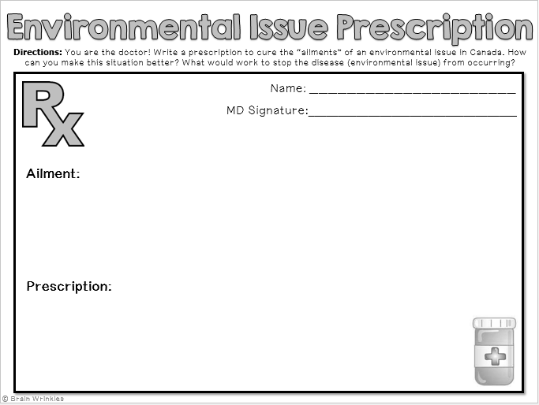
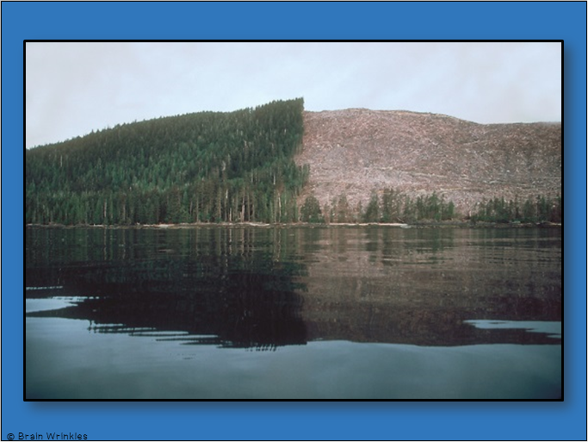
Canada’s
ENVIRONMENTAL ISSUES
ENVIRONMENTAL
ISSUES
Presentation, Graphic Organizers, & Activities

Slide 2
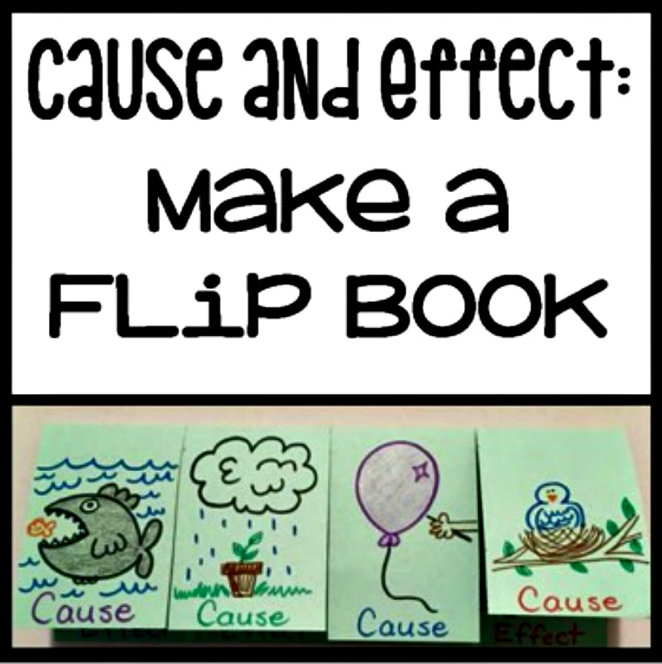

Slide 3
STANDARDS:
SS6G6 Explain the impact of environmental issues in Canada.
Explain the causes and effects of pollution and acid rain in Canada to include the Great Lakes.
Explain the causes and effects of the extraction of natural resources on the Canadian Shield (e.g., mining and logging).
© Brain Wrinkles

Slide 4
Canada’s
Environmental
Issues
Acid Rain & Pollution of the Great Lakes, Over-extraction of the Canadian Shield, & Timber Resources
© Brain Wrinkles

Slide 5
Great Lakes:
Acid Rain
& Pollution
© Brain Wrinkles

Slide 6
Acid Rain
Acid rain is rain polluted by gases released into the air by the burning of fossil fuels.
The pollutants from coal-burning factories and vehicle emissions mix with water molecules in clouds and turn the water acidic.
In Canada and the United States, the main producers of acid rain include vehicle emissions and factories and power plants that burn coal.
© Brain Wrinkles

Slide 7
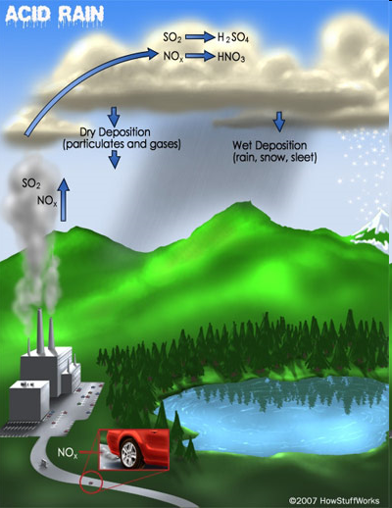
© Brain Wrinkles

Slide 8
Acid Rain
In Canada, 50-75% of the pollution that causes acid rain actually comes from the United States.
Wind patterns tend to move the poisonous emissions from the United States north into Canada.
© Brain Wrinkles

Slide 9
Acid Rain
Southern Canada (near the Great Lakes region) experiences the highest levels of acid rain.
Here, in Ontario and Quebec, the bedrock, water, and soil don’t have the ability to neutralize acid so it seeps into the ground and poisons forests, soil, and lakes.
© Brain Wrinkles

Slide 10
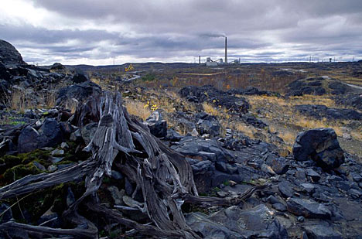
© Brain Wrinkles

Slide 11
Effects
High levels of acid rain have killed fish in thousands of lakes, including the Great Lakes.
It has polluted farmland and trees in eastern Canada.
Acid rain can also damage buildings and statues, especially those made from granite, limestone, and marble.
It has decreased profits in Canada’s fishing, forestry, and agriculture industries.
© Brain Wrinkles

Slide 12
© Brain Wrinkles

Slide 13
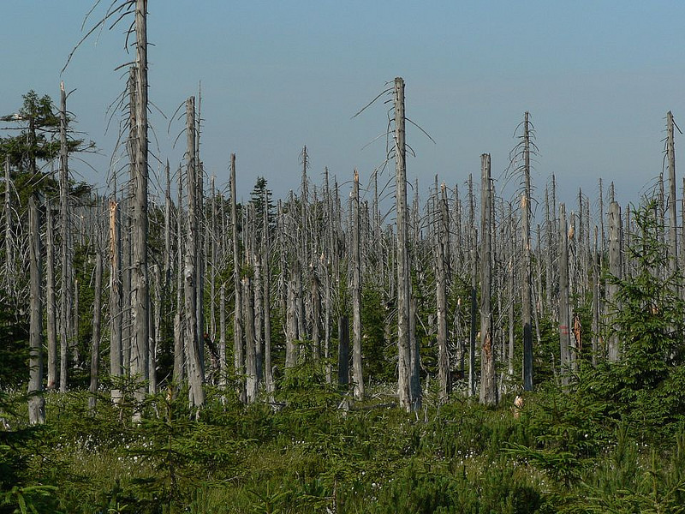
© Brain Wrinkles

Slide 14
Solutions
Canada’s government has done several things to reduce pollution:
They are building factories that don’t pollute the air.
Laws have been passed that require cars to produce less pollution.
They are encouraging people to walk or ride bikes/buses, rather than driving.
© Brain Wrinkles

Slide 15
Great Lakes
Since the 1970s, the Great Lakes have faced serious pollution problems.
The region is polluted by acid rain, waste from factories, sewage treatment plants, and runoff containing things like fertilizers and pesticides.
Thousands of plants and animals are harmed or killed by pollution.
© Brain Wrinkles

Slide 16
© Brain Wrinkles

Slide 17
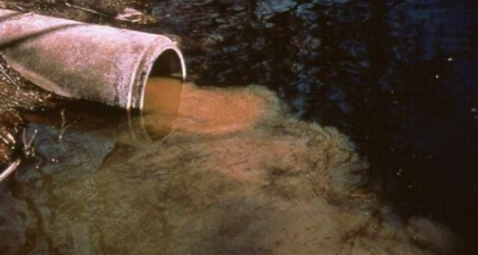
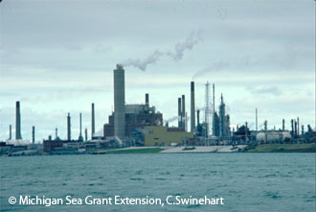
© Brain Wrinkles

Slide 18
Solutions
Because the Great Lakes are major sources of water and transportation for commerce for both Canada and the US, the countries are working together to clean up the pollution and acid rain.
The governments now regulate industries and have replaced coal-fired power plants with gas-powered ones.
They have also added lime to lakes, rivers, and soil to try to neutralize the effects of acid.
© Brain Wrinkles

Slide 19
Canadian Shield:
Extraction of
Resources
© Brain Wrinkles

Slide 20
Canadian Shield
The Canadian Shield is a large area of thin, rocky soil that surrounds the Hudson Bay.
Beneath the soil lies one of Canada’s most valuable resources -- minerals (gold, silver, copper, zinc, lead, iron ore, uranium, & nickel).
Mineral deposits are very important to Canada’s economy because they are valuable exports, fuel many of the country’s industries, and provide jobs to 1.5 million people.
© Brain Wrinkles

Slide 21
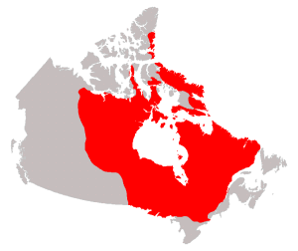
© Brain Wrinkles

Slide 22
Extraction
Mining has caused great damage to Canada’s environment.
Blasting & digging with heavy machinery damages the land around mines and destroys animals’ habitats.
Slag, or leftover rock from the smelting process, is often dumped in any convenient place and seeps into nearby ground and water sources.
Mining processes also release harmful chemicals into the air, which leads to acid rain.
© Brain Wrinkles

Slide 23
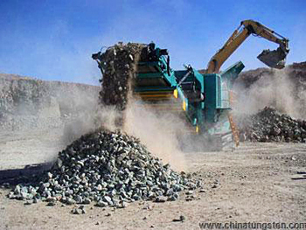
© Brain Wrinkles

Slide 24
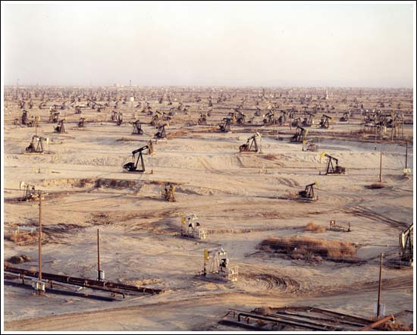
© Brain Wrinkles

Slide 25
Solution
Since the extraction and use of the natural resources in the Canadian Shield has caused environmental problems, Canada’s government has been working to balance economic growth with environmental preservation.
The government has made new rules about mining and is implementing plans to monitor the process more closely.
© Brain Wrinkles

Slide 26
Timber
Resources
© Brain Wrinkles

Slide 27
Timber Industry
With almost half its land covered in forests, Canada is a leading producer of timber products.
These products include lumber, paper, plywood, and wood pulp.
The major timber-producing provinces include British Columbia, Quebec, and Ontario.
© Brain Wrinkles

Slide 28
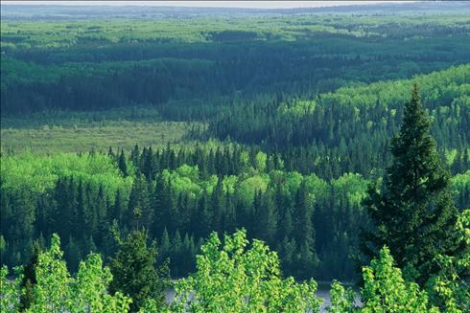
© Brain Wrinkles

Slide 29
Clearcutting
Most timber companies cut all the trees in a given area, leaving large treeless gaps in the forest (called “clearcutting”).
Heavy machinery leaves the forest floor compacted and makes it hard for new growth to start.
This reduces water quality and kills animals’ habitats.
Clearcutting also causes erosion, which can lead to flooding.
© Brain Wrinkles

Slide 30
© Brain Wrinkles

Slide 31
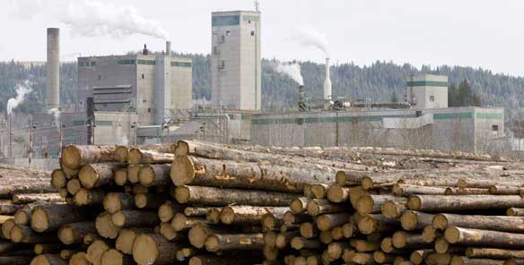
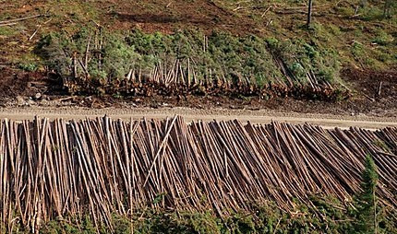
© Brain Wrinkles

Slide 32
Solutions
Government and industries are working together to manage use of the forests.
Hundreds of millions of seedlings are planted each year, although, it takes decades for a forest to reappear.
Billions of dollars are spent on managing and protecting the forests.
Canada’s government has also set aside protected land in parks and reserves.
© Brain Wrinkles

Slide 33
TEACHER INFO:
Print off the following slide for each student.
They should complete the chart while discussing the presentation.
Check answers as a class when finished. If time, have students color their pictures.
© Brain Wrinkles

Slide 34
TEACHER INFO: Design A Shirt
Print off the Design A Shirt page for each student.
Students should design a t-shirt that will convince others to help solve one of Canada’s environmental issues.
On the front -- Create a slogan for the shirt. (This needs to be a thoughtful message or statement that describes the environmental issue and how it can be solved.) Draw a colorful visual for the shirt.
On the back -- write a paragraph to describe the environmental issue and your ideas for how it can be solved.
© Brain Wrinkles

Slide 35
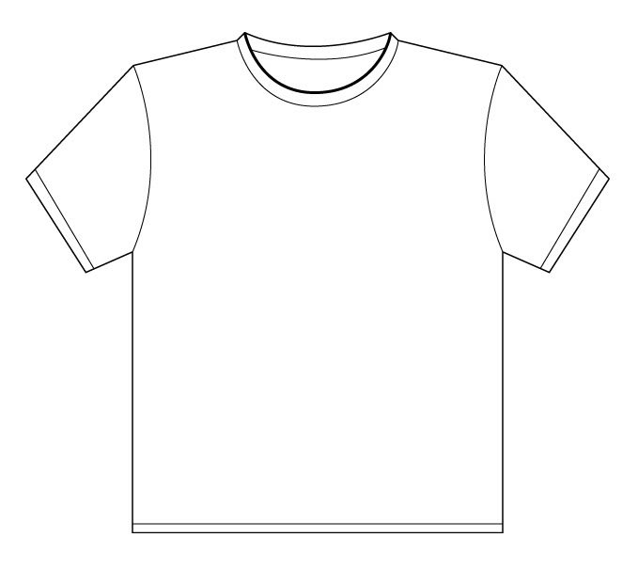
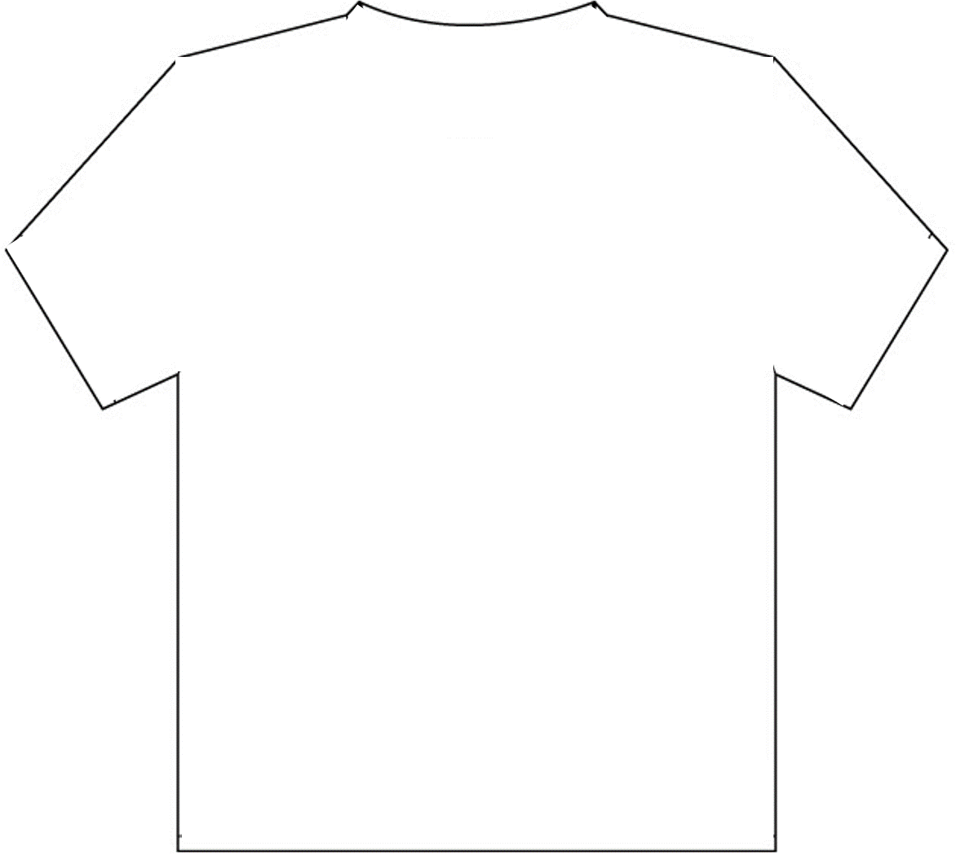
Design A T-Shirt
Directions: Design a t-shirt that will convince others to help solve one of Canada’s environmental issues. On the front -- Create a slogan for the shirt. (This needs to be a thoughtful message or statement that describes the environmental issue and how it can be solved.) Draw a colorful visual for the shirt. On the back -- write a paragraph to describe the environmental issue and your ideas for how it can be solved.
Front
Back
© Brain Wrinkles

Slide 36
Environmental Issue Prescription
Directions: You are the doctor! Write a prescription to cure the “ailments” of an environmental issue in Canada. How can you make this situation better? What would work to stop the disease (environmental issue) from occurring?
Name: ______________________
MD Signature:___________________________________
Ailment:
Prescription:
© Brain Wrinkles

Slide 37
Name:
Name:
What Stuck
With You?
What Stuck
With You?
What is the most important thing that you remember from today’s lesson?
What is the most important thing that you remember from today’s lesson?
© Brain Wrinkles
© Brain Wrinkles

Slide 38
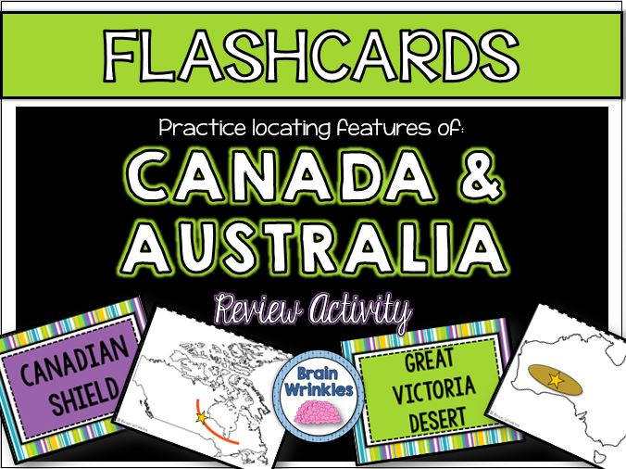
Thank You!
Thank you so much for downloading this file. I sincerely hope you find it helpful and that your students learn a lot from it! I look forward to reading your feedback in my store.
If you like this file, you might want to check out some of my other products that teach social studies topics in creative, engaging, and hands-on ways.
Best wishes,
Ansley at Brain Wrinkles

Slide 39
© Brain Wrinkles. Your download includes a limited use license from Brain Wrinkles. The purchaser may use the resource for personal classroom use only. The license is not transferable to another person. Other teachers should purchase their own license through my store.
This resource is not to be used:
By an entire grade level, school, or district without purchasing the proper number of licenses. For school/district licenses at a discount, please contact me.
As part of a product listed for sale or for free by another individual.
On shared databases.
Online in any way other than on password-protected website for student use only.
© Copyright Brain Wrinkles. All rights reserved. Permission is granted to copy pages specifically designed for student or teacher use by the original purchaser or licensee. The reproduction of any other part of this product is strictly prohibited. Copying any part of this product and placing it on the Internet in any form (even a personal/classroom website) is strictly forbidden. Doing so makes it possible for an Internet search to make the document available on the Internet, free of charge, and is a violation of the Digital Millennium Copyright Act (DMCA).
Thank you,
Ansley at Brain Wrinkles
Terms of Use
Clipart, fonts, & digital papers for this product were purchased from:

